Slide 1
Hadron Calorimeter

Slide 2
Outline
Introduction to basic concepts
Interactions
Showers
Hadron-Barrel Calorimeter
Hadron-Outer calorimeter
Hybrid Photodiode

Slide 3
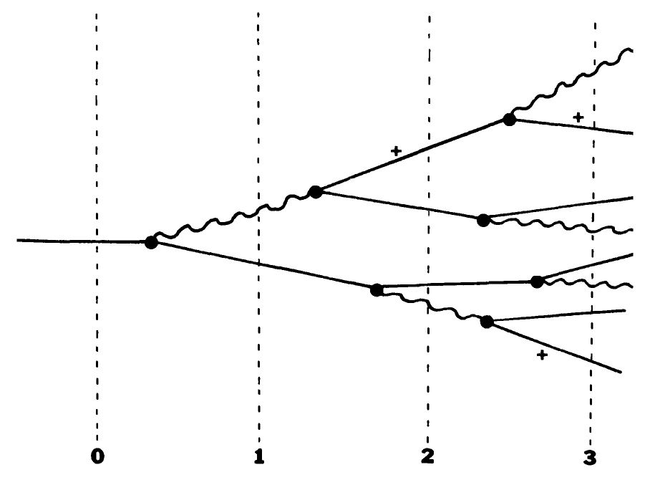
Electromagnetic Shower

Slide 4
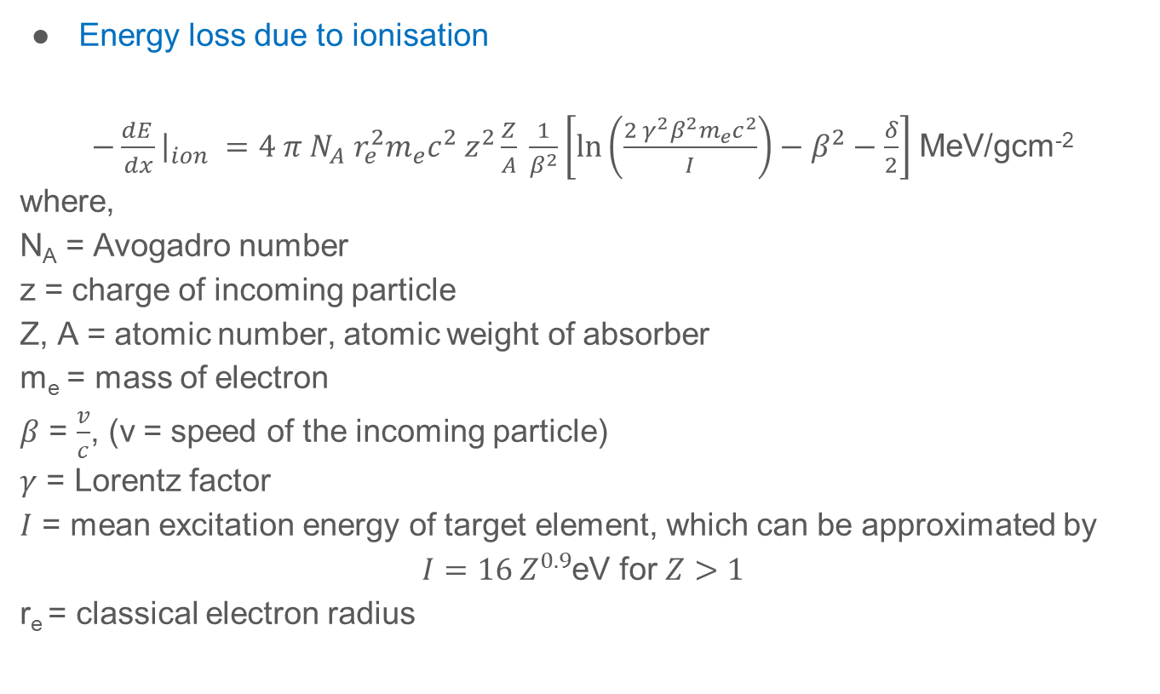

Energy loss due to ionisation
$−\frac{dE_{ }}{dx}{\left.​\right|}_{ion} =4 π N_{A} r_{e}^{2}m_{e}c^{2} z^{2}\frac{Z}{A} \frac{1}{β^{2}}\left[\ln\left(\frac{2{ γ}^{2}β^{2}m_{e}c^{2}}{I}\right)−β^{2}−\frac{δ}{2}\right]$ MeV/gcm⁻²
where,
N_{A} = Avogadro number
z = charge of incoming particle
Z, A = atomic number, atomic weight of absorber
m_{e} = mass of electron
$β$ = $\frac{v}{c}$, (v = speed of the incoming particle)
$γ$ = Lorentz factor
$I$ = mean excitation energy of target element, which can be approximated by
$I=16 Z^{0.9}$eV for $Z>1$
r_{e} = classical electron radius
Function of :
Speed of the incident particle:
At low energies $\left(γβ<1\right)→\frac{1}{β^{2}}$
At high energies, slow variation
due to $\ln\left(γ\right)$
Mean Excitation energy $ℏ〈ω〉$
Notes:
Soft collisons: Kinetic energy (T) of the atomic collision after collision is less than the T_{max}. Reverse for Hard collisions

Slide 5
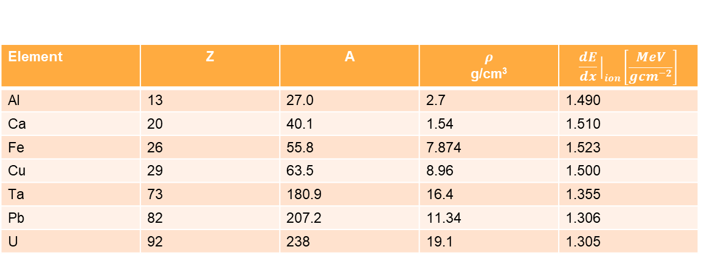

$δ−$ screening parameter
$4 π N_{A} r_{e}^{2}m_{e}c^{2}=0.3071$ MeV/gcm⁻²
At very high energies,
$\frac{δ}{2}=ln\frac{{28.8\sqrt{ρ〈\frac{Z}{A}〉}} }{I} +\ln{βγ} −\frac{1}{2}$
Average energy loss by 225 GeV muon in various materials
Element | Z | A | $$ρ$$ g/cm³ | $$\frac{dE}{dx}{\left.​\right|}_{ion}\left[\frac{MeV}{gcm^{−2}}\right]$$
Al | 13 | 27.0 | 2.7 | 1.490
Ca | 20 | 40.1 | 1.54 | 1.510
Fe | 26 | 55.8 | 7.874 | 1.523
Cu | 29 | 63.5 | 8.96 | 1.500
Ta | 73 | 180.9 | 16.4 | 1.355
Pb | 82 | 207.2 | 11.34 | 1.306
U | 92 | 238 | 19.1 | 1.305

Slide 6
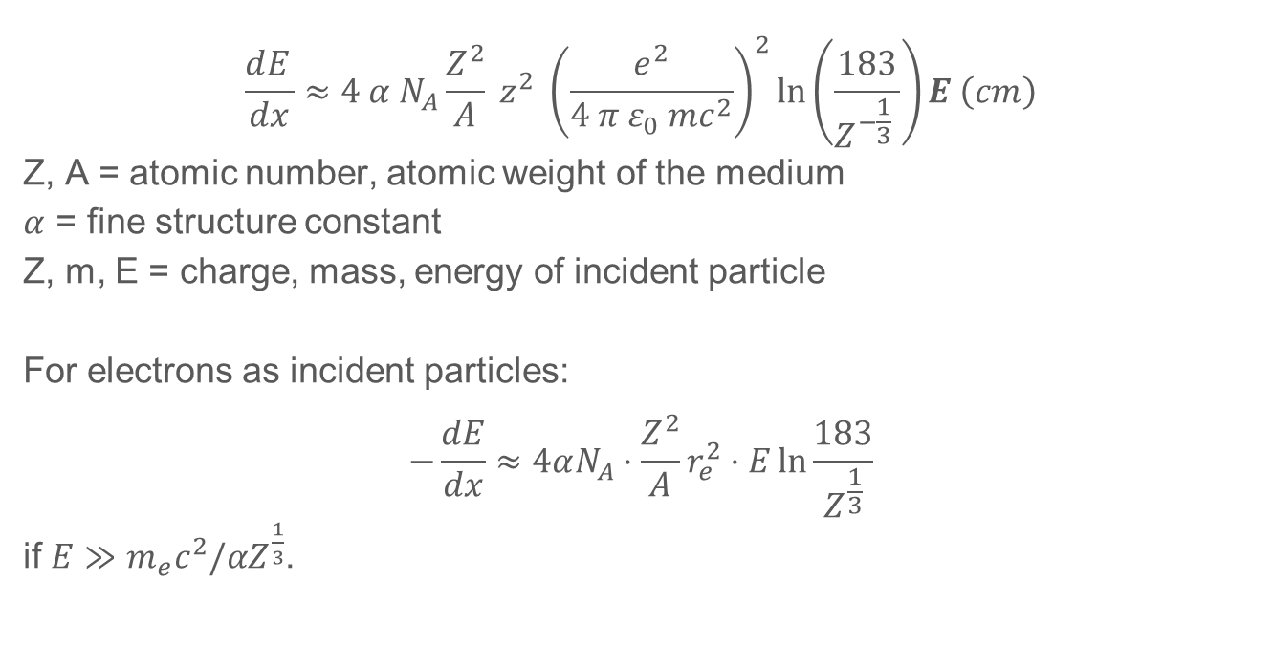
Radiation loss (Bremsstrahlung)
$$\frac{dE_{ }}{dx}≈4 α N_{A}\frac{Z^{2}}{A} z^{2} {\left(\frac{e^{2}}{4 π ε_{0} mc^{2}}\right)}^{2}\ln\left(\frac{183}{Z^{−\frac{1}{3}} }\right)E \left(cm\right)$$
Z, A = atomic number, atomic weight of the medium
$α$ = fine structure constant
Z, m, E = charge, mass, energy of incident particle
For electrons as incident particles:
$$−\frac{dE}{dx}≈4αN_{A}⋅\frac{Z^{2}}{A}r_{e}^{2}⋅E\ln{\frac{183}{Z^{\frac{1}{3}}}}$$
if $E≫m_{e}c^{2}/αZ^{\frac{1}{3}}$.

Slide 7
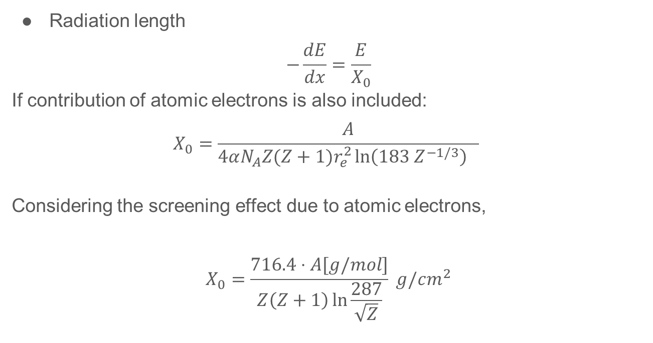
Radiation length
$$−\frac{dE}{dx}=\frac{E}{X_{0}}$$
If contribution of atomic electrons is also included:
$$X_{0}=\frac{A}{4αN_{A}Z(Z+1)r_{e}^{2}\ln\left(183 Z^{−1/3}\right) }$$
Considering the screening effect due to atomic electrons,
$$X_{0}=\frac{716.4⋅A[g/mol]}{Z\left(Z+1\right)\ln{\frac{287}{\sqrt{Z}}}} g/cm^{2}$$

Slide 8
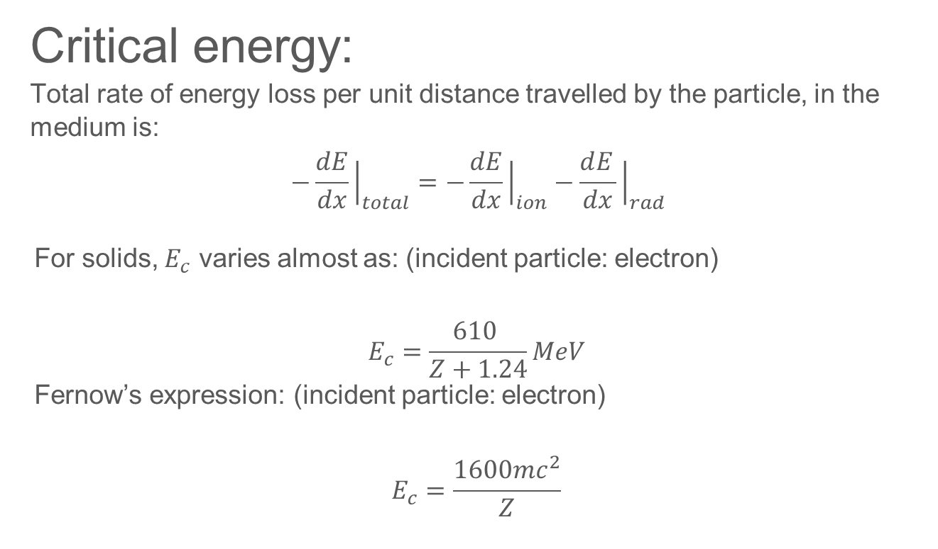
Critical energy:
Total rate of energy loss per unit distance travelled by the particle, in the medium is: $$−\frac{dE}{dx}{\left.​\right|}_{total}=−\frac{dE}{dx}{\left.​\right|}_{ion}−\frac{dE_{ }}{dx}{\left.​\right|}_{rad}$$
For solids, $E_{c}$ varies almost as: (incident particle: electron)
$$E_{c}=\frac{610 }{Z+1.24}MeV$$
Fernow’s expression: (incident particle: electron)
$$E_{c}=\frac{1600mc^{2}}{Z}$$

Slide 9
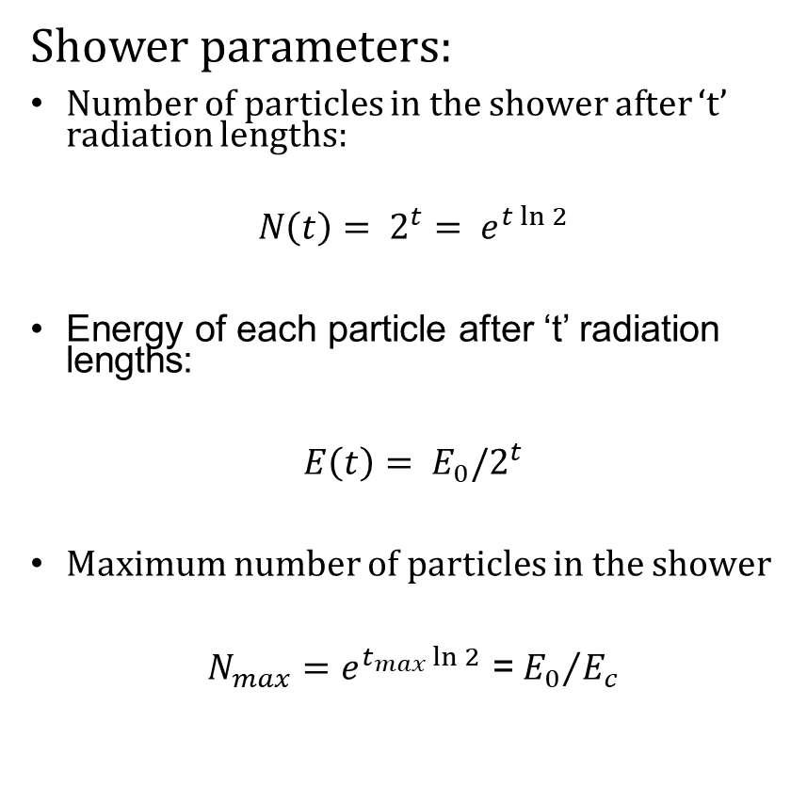
Shower parameters:
Number of particles in the shower after ‘t’ radiation lengths:
$$N\left(t\right)= 2^{t}= e^{t\ln{2}}$$
Energy of each particle after ‘t’ radiation lengths:
$E\left(t\right)= E_{0}/2^{t}$­
Maximum number of particles in the shower
$N_{max}=e^{t_{max}\ln{2}}$ =${{ E}_{0}}/{E_{c}}$
E_{c} of electron and muon
Element | Z | E_{c} Electron MeV/c² | E_{c} Muon MeV/c²
Si | 14 | 40.0262 | 1.7101
Pb | 82 | 7.3282 | 0.3131
Al | 13 | 42.8371 | 1.8302
Fe | 26 | 22.3935 | 0.9568
Cu | 29 | 20.1719 | 0.8618
W | 74 | 8.1074 | 0.3464

Slide 10
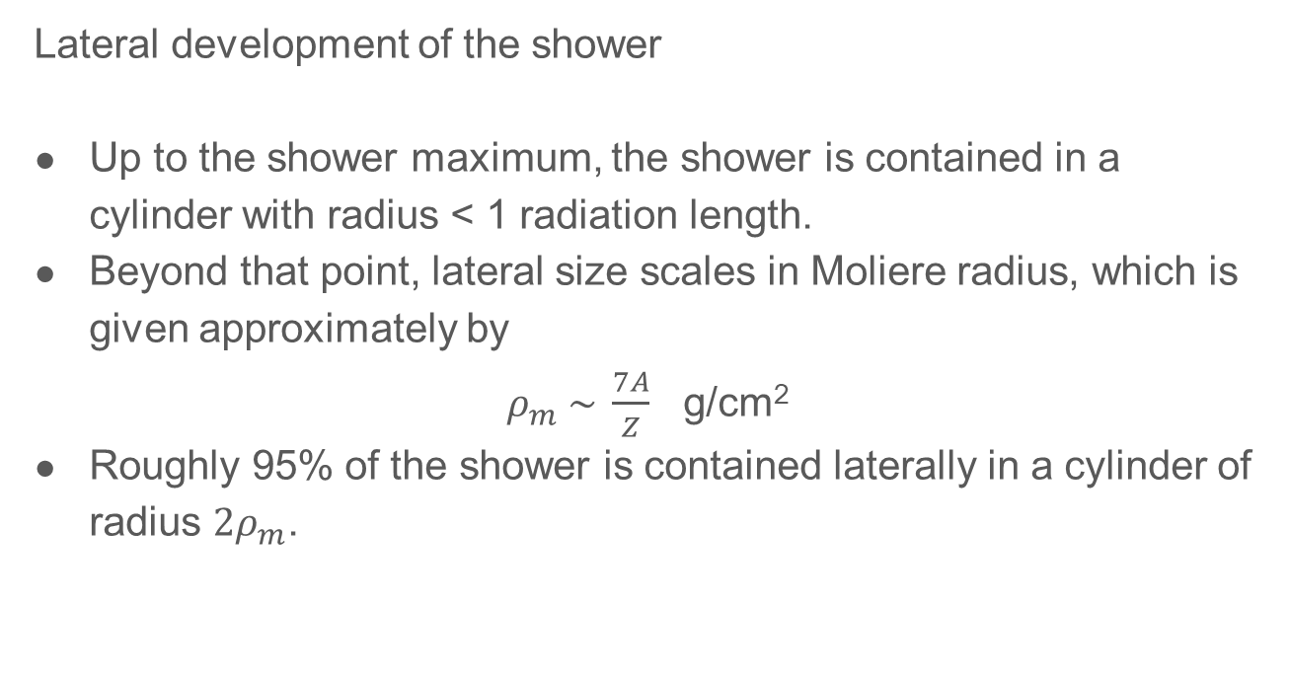
Lateral development of the shower
Up to the shower maximum, the shower is contained in a cylinder with radius < 1 radiation length.
Beyond that point, lateral size scales in Moliere radius, which is given approximately by
$ρ_{m} \sim \frac{7A}{Z}$ g/cm²
Roughly 95% of the shower is contained laterally in a cylinder of radius $2ρ_{m}$.

Slide 11
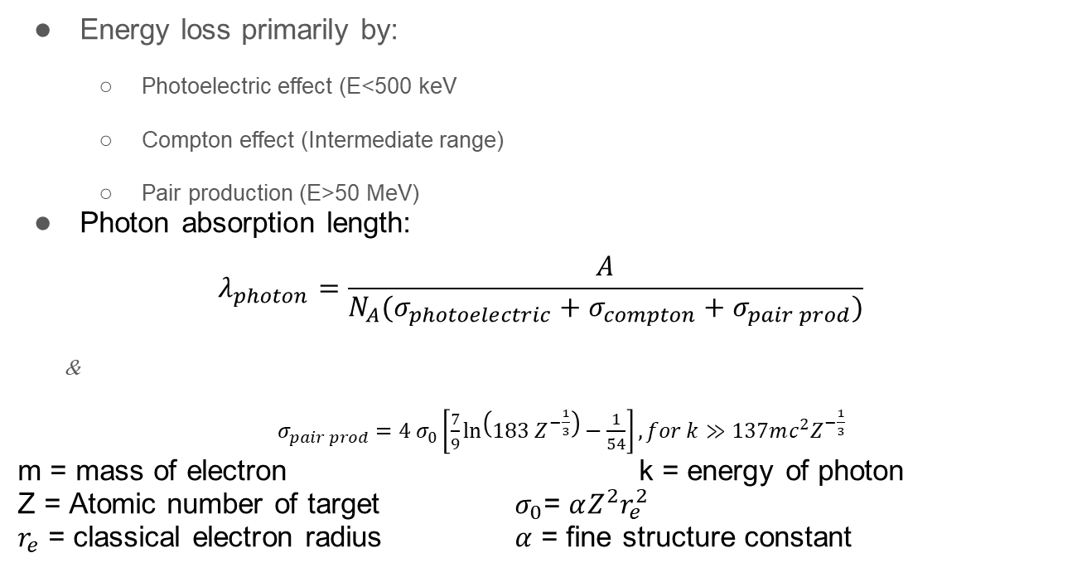
Interaction of photons
Energy loss primarily by:
Photoelectric effect (E<500 keV
Compton effect (Intermediate range)
Pair production (E>50 MeV)
Photon absorption length:
$$λ_{photon}=\frac{A}{N_{A}(σ_{photoelectric}+σ_{compton}+σ_{pair prod})}$$
&
$σ_{pair prod}=4 σ_{0}\left[\frac{7}{9}\ln\left(183 Z^{−\frac{1}{3}}\right)−\frac{1}{54}\right], for k≫137mc^{2}Z^{−\frac{1}{3}}$
m = mass of electron k = energy of photon
Z = Atomic number of target $σ_{0}$= $αZ^{2}r_{e}^{2}$
$r_{e}$ = classical electron radius $α$ = fine structure constant

Slide 12
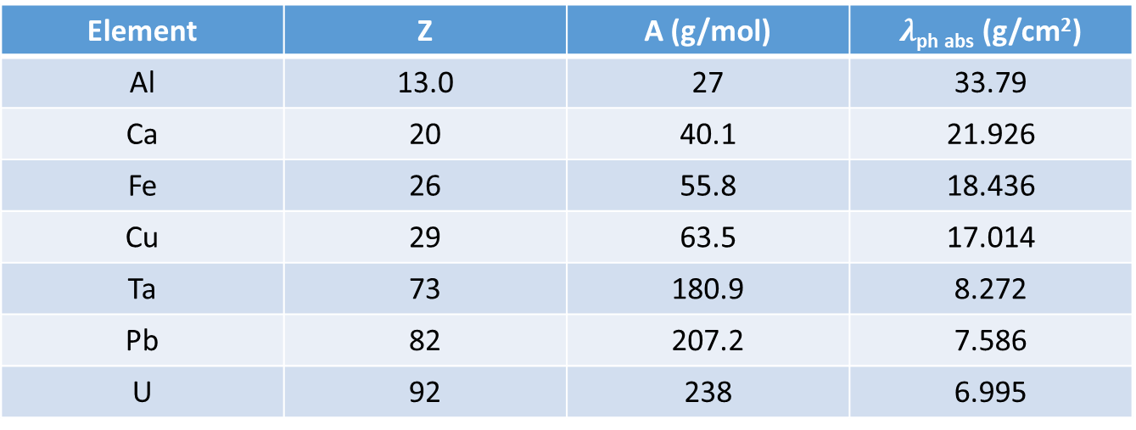
Photon absorption length for some elements:
At high energies where pair production is dominant
Element | Z | A (g/mol) | $λ$_{ph abs} (g/cm²)
Al | 13.0 | 27 | 33.79
Ca | 20 | 40.1 | 21.926
Fe | 26 | 55.8 | 18.436
Cu | 29 | 63.5 | 17.014
Ta | 73 | 180.9 | 8.272
Pb | 82 | 207.2 | 7.586
U | 92 | 238 | 6.995

Slide 13
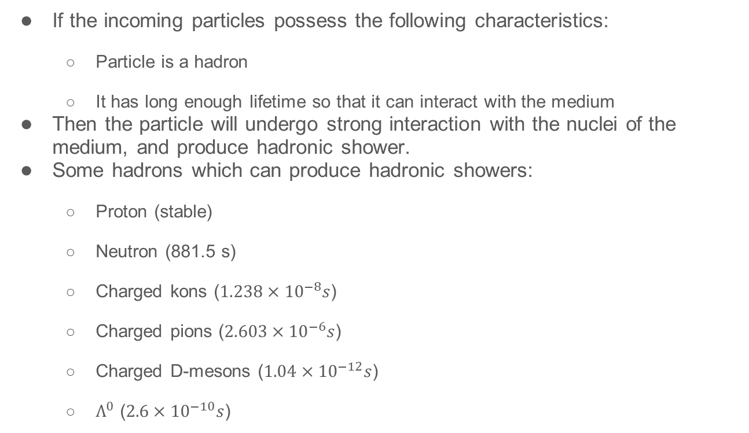
Hadronic Showers
If the incoming particles possess the following characteristics:
Particle is a hadron
It has long enough lifetime so that it can interact with the medium
Then the particle will undergo strong interaction with the nuclei of the medium, and produce hadronic shower.
Some hadrons which can produce hadronic showers:
Proton (stable)
Neutron (881.5 s)
Charged kons ($1.238×{10}^{−8}s$)
Charged pions ($2.603×{10}^{−6}s$)
Charged D-mesons ($1.04×{10}^{−12}s$)
$Λ^{0}$ ($2.6×{10}^{−10}s$)

Slide 14
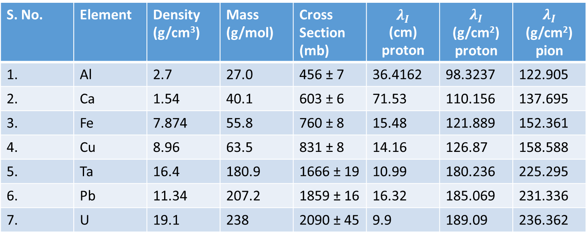
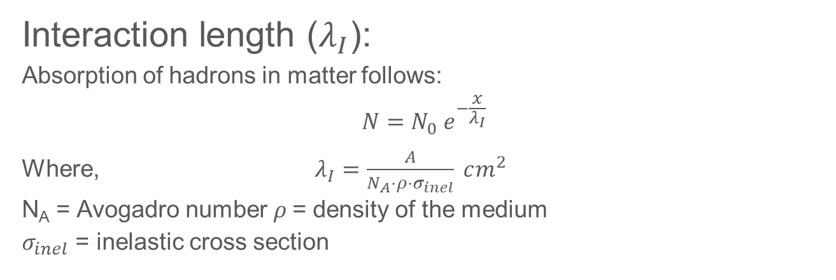
Interaction length ($λ_{I}$):
Absorption of hadrons in matter follows:
$$N=N_{0} e^{−\frac{x}{λ_{I}}}$$
Where, $λ_{I}=\frac{A}{N_{A}⋅ρ⋅σ_{inel}} cm^{2}$
N_{A} = Avogadro number$ρ$ = density of the medium
$σ_{inel}$ = inelastic cross section

Slide 15
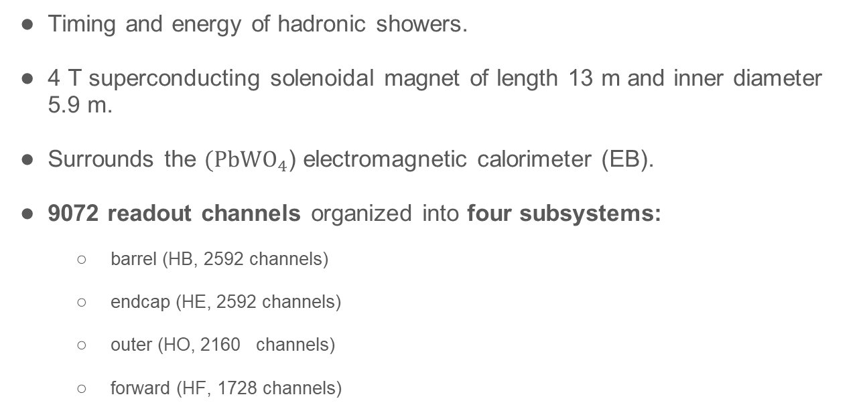
HCAL
Timing and energy of hadronic showers.
4 T superconducting solenoidal magnet of length 13 m and inner diameter 5.9 m.
Surrounds the $(PbWO_{4}$) electromagnetic calorimeter (EB).
9072 readout channels organized into four subsystems:
barrel (HB, 2592 channels)
endcap (HE, 2592 channels)
outer (HO, 2160 channels)
forward (HF, 1728 channels)

Slide 16
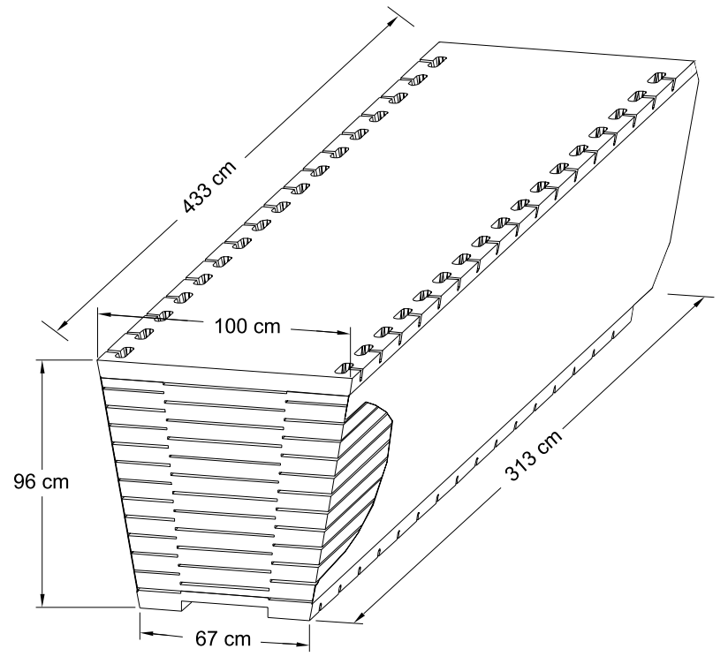
Design
Pseudorapidity range −1.3 < η < 1.3.
Two half-barrels (HB+ and HB–), 36 identical azimuthal wedges (∆φ = 20◦)
Four azimuthal (∆φ = 5◦) sectors.
The scintillator is divided into 16 η sectors, resulting in a segmentation of (∆η, ∆φ) = (0.087, 0.087).

Slide 17
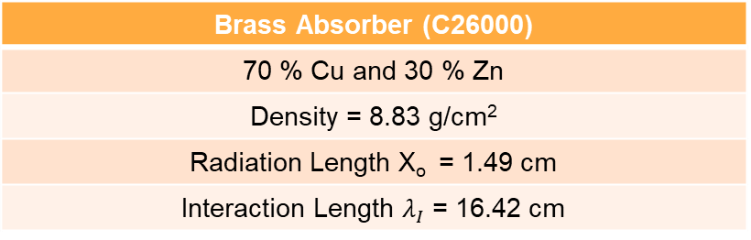

Absorber Geometry
The HB effective thickness increases with polar angle; 10.6 $λI$ at |η| = 1.3.
EB adds $∼1.1λI$.
Back Steel Plate (75 mm)
6 Brass plates (56.5 mm)
8 Brass plates (50.5 mm)
Front Steel Plate (40 mm)
Beam Direction
Brass Absorber (C26000)
70 % Cu and 30 % Zn
Density = 8.83 g/cm²
Radiation Length X_{o} = 1.49 cm
Interaction Length $λ_{I}$ = 16.42 cm

Slide 18
2.2 Scintillator
CMS HCAL active elements consist of about 70,000 scintillator tiles.
Tray:
Single azimuthal Section and a depth layer are grouped into a single scintillator unit referred to as a tray.
Made of individual optically independent scintillators with white painted edges wrapped in Tyvek 1073D sheets.
HB Scintillator
A 3.7-mm thick Kuraray SCSN81 plate was used
Long term stability and acceptable radiation hardness
First layer (Layer-0) is made of 9-mm thick Bicron BC408.
Last layer (Layer-16) is 9-mm thick Kuraray SCSN81.
Used to oversample early and late developing showers

Slide 19
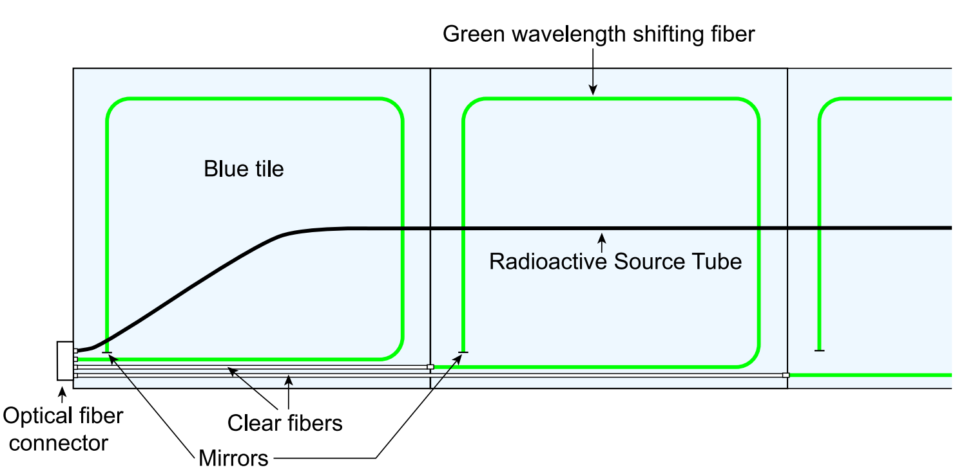
Fig: Schematic of a partial scintillator tray
Source: CMS NOTE 2006/138
Wavelength shifting fiber (Kuraray Y11)
Green double clad, 0.94 – mm diameter
Mirrored at the tip; average reflectivity ∼ 83% with a spread of about 6.5%
Spliced to clear fibers; transmission efficiency: 92.6%, rms :1.8%

Slide 20
Scintillator plates
WLS
Clear Fibers
Optical connector
Optical unit
Hybrid photodiode
(HPD)
Source tube
1-mm diameter stainless steel tube, for calibration purposes
Guides a 137Cs (or 60Co) source welded on the tip of a thin stainless steel wire across the center of each tile in a tray
Used during the assembly stage, to guide the wire source.
RMS of $\frac{\text{Light} \text{yield} \text{by} \text{collimated} \text{source}}{\text{Light} \text{yield} \text{by} \text{wire} \text{source}}$=1.3%.
Wire sources can be used to calibrate individual tiles to better than 2%
Arranges the fibers into readout towers
Testing of the tray
Collimated ¹³⁷Cs source, illuminated a 4-cm diameter spot on the tray
Determined the relative yield of each tile and uniformity of each tray.
RMS of response and transverse uniformity of each tile = 4.6%, spread of 4.5%
Results imply - tile uniformity contributes negligibly to the fractional energy resolution of the HCAL.

Slide 21
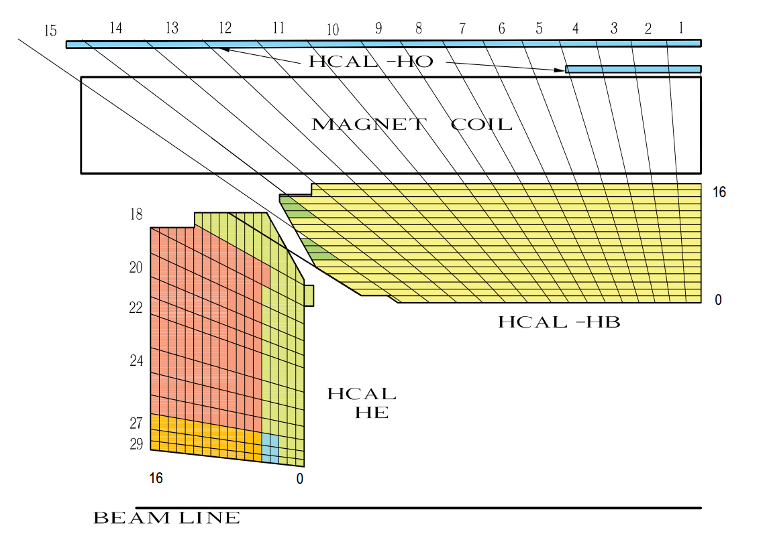
2.3 Longitudinal Segmentation
Tower number
Scintillator layer number
Figure 4: The HCAL tower segmentation for one-fourth of the HB, HO, and HE detectors.The shading
represents independent longitudinal readouts in the HB/HE overlap and the small angle regions.

Slide 22
Towers 1 through 14, all have a single longitudinal readout
Towers 15 and 16 are segmented in depth.
Front segment of Tower 15 contains either 12 or 13 scintillator layers.
Rear segment of Tower 15 has three scintillator layers.
Tower 16 has five layers in the front segment and three in the rear.
Tower 16 does not have a Layer-0 scintillator.

Slide 23
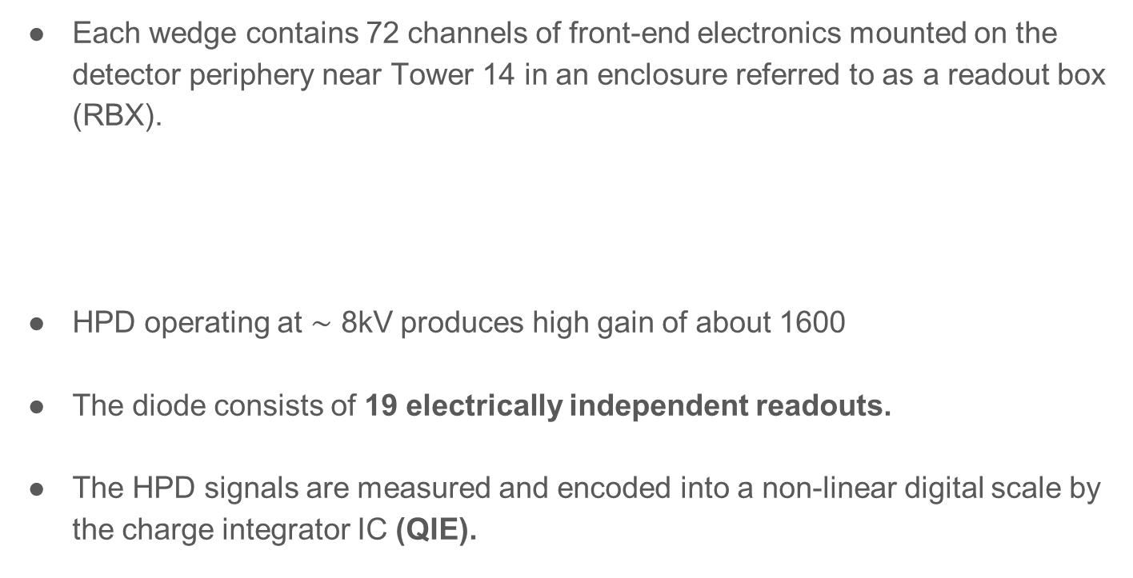
Electronics and Data Acquisition
Each wedge contains 72 channels of front-end electronics mounted on the detector periphery near Tower 14 in an enclosure referred to as a readout box (RBX).
HPD operating at $\sim$ 8kV produces high gain of about 1600
The diode consists of 19 electrically independent readouts.
The HPD signals are measured and encoded into a non-linear digital scale by the charge integrator IC (QIE).
RBX
Each RBX is divided into
Readout
19-channel HPD
four readout modules
Modules

Slide 24
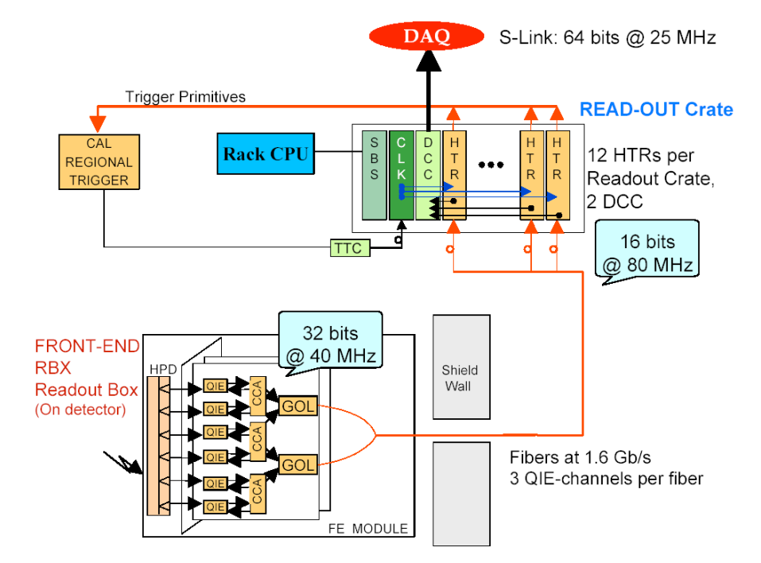
Trigger and Readout Modules

Slide 25
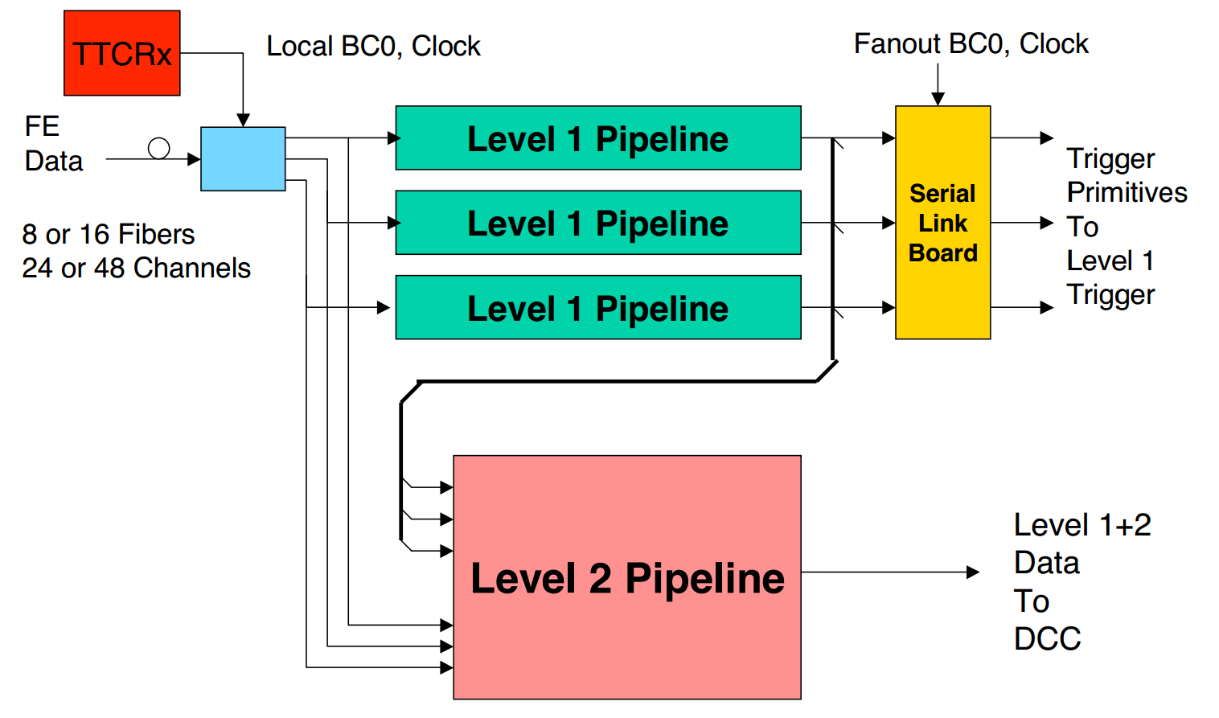
The HTR includes two data pipe-lines:
The trigger pipe-line: assigns the front-end data to a particular LHC bunch crossing and sends them to the CMS trigger.
The data acquisition pipe-line stacks the frontend data and sends it to the DCC which performs the data acquisition task.
The raw input data stream is de-serialized and synchronized to the local clock.
A programmable delay of up to a few clock cycles is used to align data from different input fibers.

Slide 26
Data Concentrator Card
Event building, protocol checking, event number checking and bit error correction are performed independently for each link.
The event builder output is sent in parallel to several destinations.
The data acquisition (DAQ) output: Every event is sent to the CMS DAQ.
The trigger data output: The trigger information sent to the CMS Level-1 trigger is also sent to a special trigger DAQ system for monitoring of the trigger performance.
The spy output: A selected subset of events is sent to a VME-accessible memory for monitoring and diagnostics.
Prototype electromagnetic crystal calorimeter
2D movement of platform
Test Beam Setup

Slide 27
ECAL Module
ECAL module: 49 lead tungstate crystals arranged in a 7 × 7 array.
Each crystal coupled to a single photo-multiplier tube
The PMT signals were digitized by charge-to-digital converters (QDC).
Data Sets
Beams - directed into the centers of all towers
limited to the bottom two 5◦ sectors of the top
wedge for mechanical reasons
The scan covered the entire η range (16 sectors).
These data were taken without the electromagnetic calorimeter module
Electron (GeV/c) | Pion (GeV/c) | Muon (GeV/c)
20 | 20 | 225
30 | 30
50 | 50
100 | 100
 | 300

Slide 28
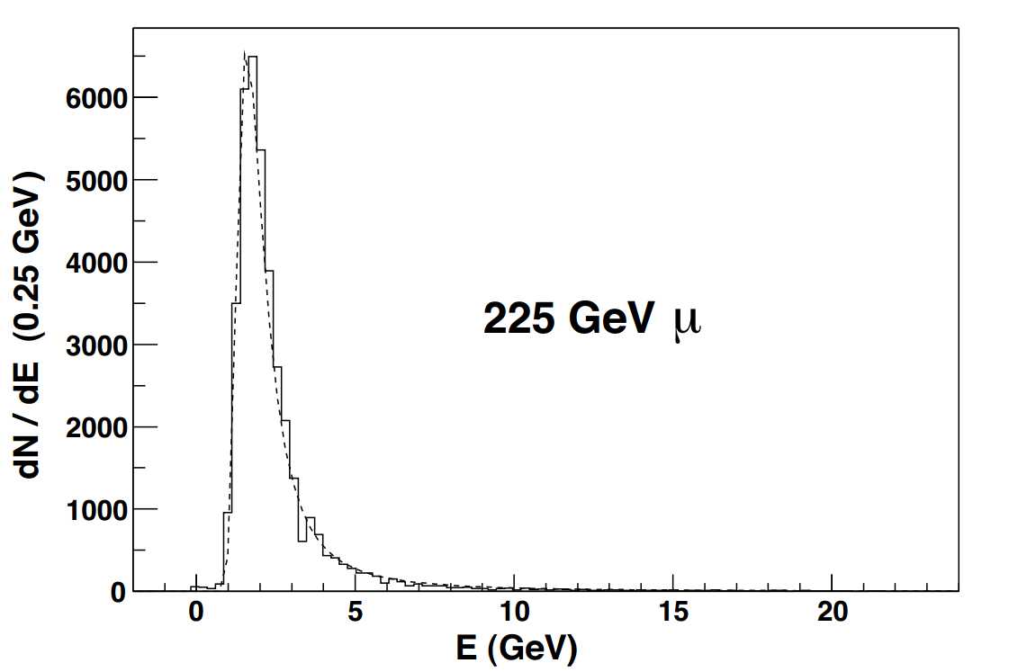
Several special runs :
Taken with the moving radioactive wire source and with a LED pulser which illuminated the HPD.
The measurements included a complete radioactive sourcing of all scintillator tiles
The HB Response to Pions and Muons
Muons
Important to understand HB response to muons for particle identification purposes
A feature bit will be reported for use in higher level triggers, when a muon is identified by the HB.
A Landau fit to this distribution results in 1.64 GeV for the most probable and 2.5 GeV for the mean value.

Slide 29
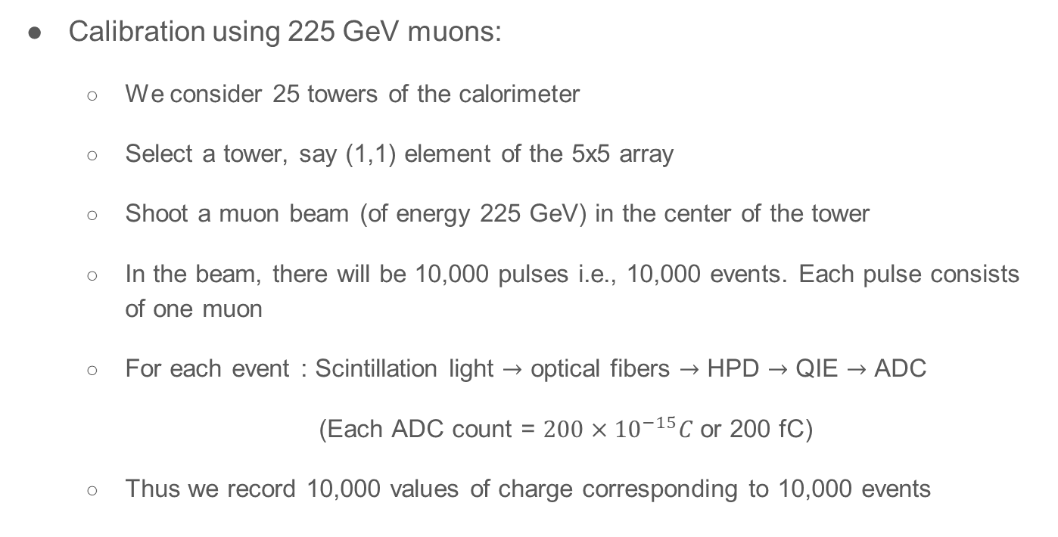
To measure the energy of pion
Calibration using 225 GeV muons:
We consider 25 towers of the calorimeter
Select a tower, say (1,1) element of the 5x5 array
Shoot a muon beam (of energy 225 GeV) in the center of the tower
In the beam, there will be 10,000 pulses i.e., 10,000 events. Each pulse consists of one muon
For each event : Scintillation light $→$ optical fibers $→$ HPD $→$ QIE $→$ ADC
(Each ADC count = $200×{10}^{−15}C$ or 200 fC)
Thus we record 10,000 values of charge corresponding to 10,000 events

Slide 30
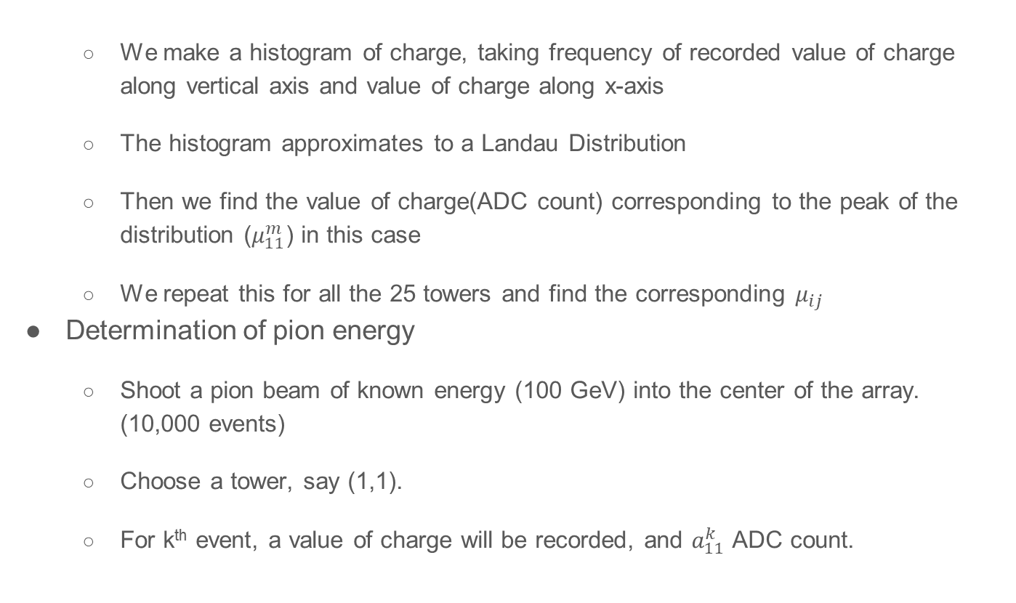
We make a histogram of charge, taking frequency of recorded value of charge along vertical axis and value of charge along x-axis
The histogram approximates to a Landau Distribution
Then we find the value of charge(ADC count) corresponding to the peak of the distribution ($μ_{11}^{m}$) in this case
We repeat this for all the 25 towers and find the corresponding $μ_{ij}$
Determination of pion energy
Shoot a pion beam of known energy (100 GeV) into the center of the array. (10,000 events)
Choose a tower, say (1,1).
For k^{th} event, a value of charge will be recorded, and $a_{11}^{k}$ ADC count.

Slide 31
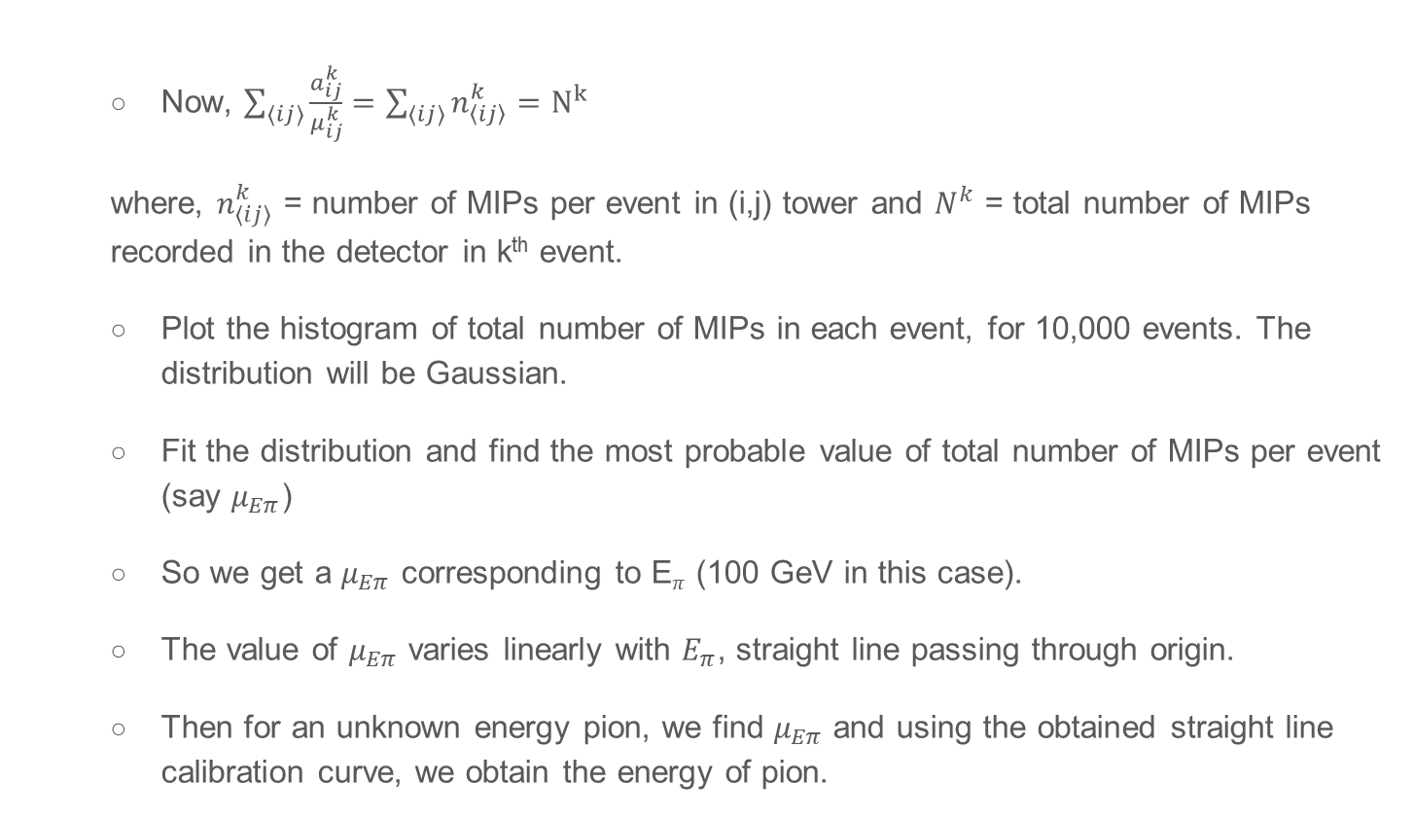
Now, $\sum_{〈ij〉}^{ }{\left.\frac{a_{ij}^{k}}{μ_{ij}^{k}}\right.}=\sum_{〈ij〉}{n_{〈ij〉}^{k}}=N^{k}$
where, $n_{〈ij〉}^{k}$ = number of MIPs per event in (i,j) tower and $N^{k}$ = total number of MIPs recorded in the detector in k^{th} event.
Plot the histogram of total number of MIPs in each event, for 10,000 events. The distribution will be Gaussian.
Fit the distribution and find the most probable value of total number of MIPs per event (say $μ_{Eπ}$)
So we get a $μ_{Eπ}$ corresponding to E$π$ (100 GeV in this case).
The value of $μ_{Eπ}$ varies linearly with $E_{π}$, straight line passing through origin.
Then for an unknown energy pion, we find $μ_{Eπ}$ and using the obtained straight line calibration curve, we obtain the energy of pion.

Slide 32
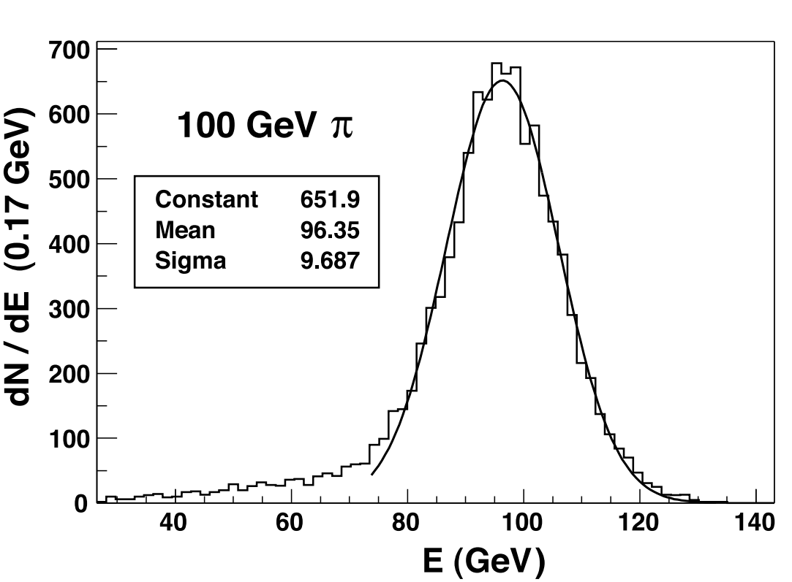
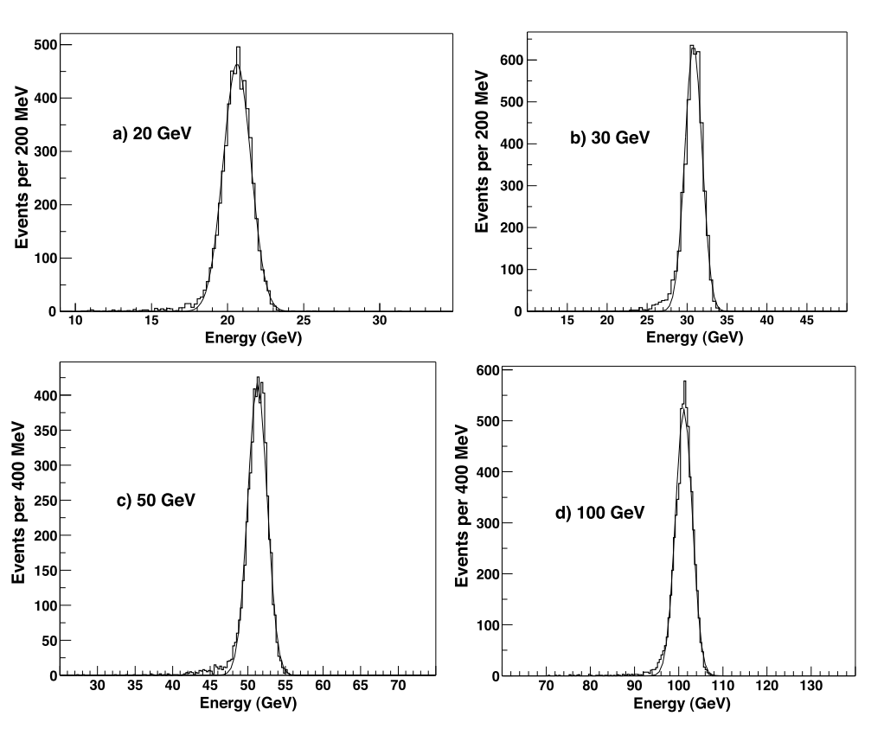
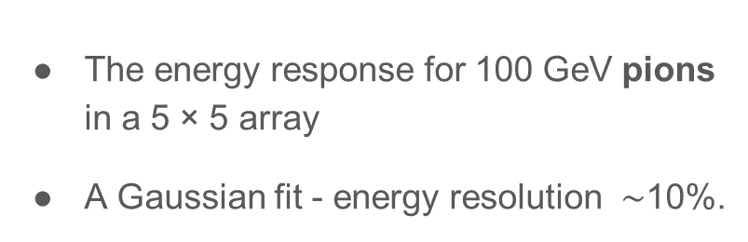
The energy response for 100 GeV pions in a 5 × 5 array
A Gaussian fit - energy resolution $\sim$10%.
The EB response to electrons
All 49 electromagnetic calorimeter crystals were calibrated with 100 GeV/c electrons.
The linearity of response of the EB module was studied at electron beam energies of 20, 30, 50 and 100 GeV/c.

Slide 33
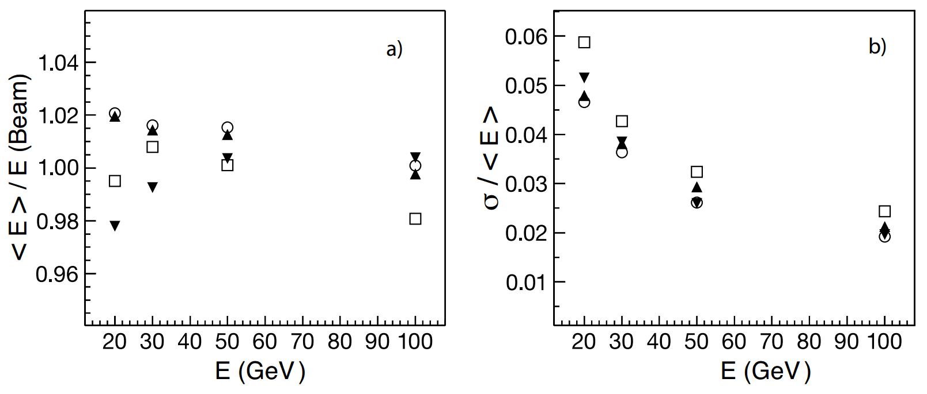
The linearity of energy response as a function of beam energy derived from the Gaussian fits.
Performance of the combined calorimeters: EB+HB
Energy Resolution and Response:
The performance characteristics of the HB and the EB module were studied with pion beams of varying momenta contaminated with muons and electrons.
The absolute energy scale of the HB was defined using a beam of 50 GeV/c pions directed at the combined calorimeter systems.

Slide 34
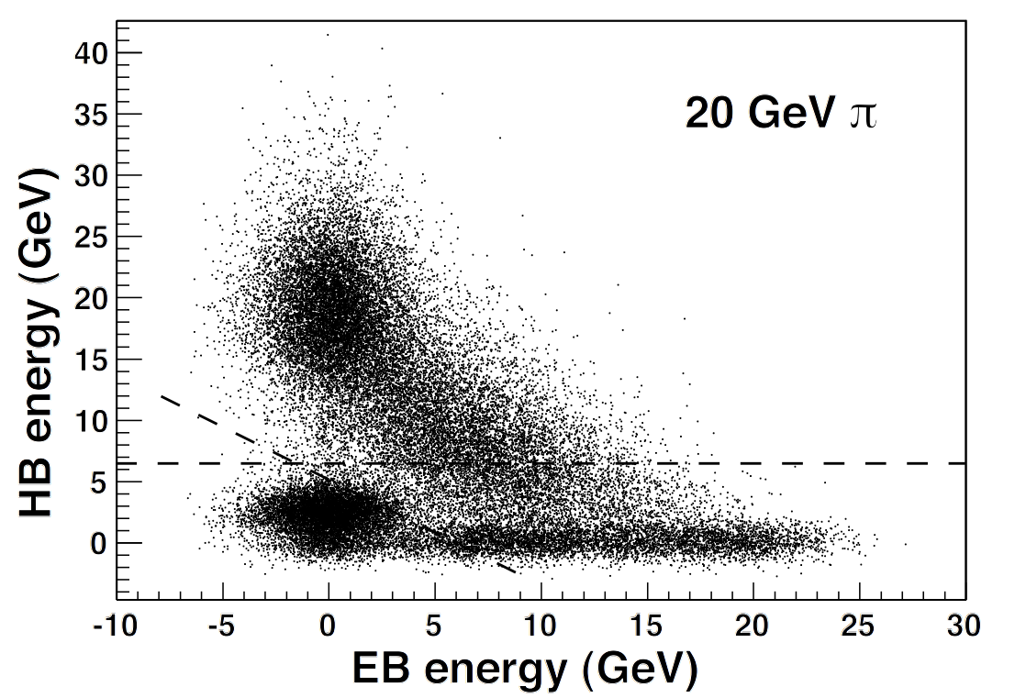
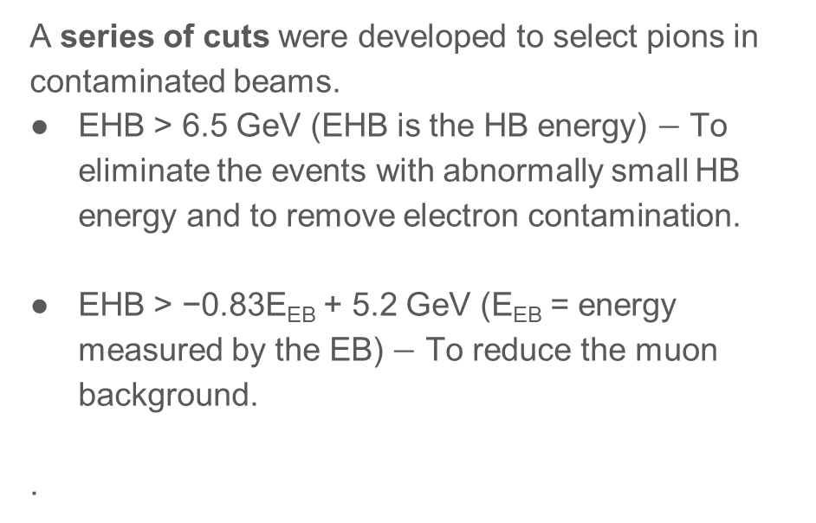
Only those pions which deposited less than 2 GeV in the EB were selected for the HB calibration.
The calibration factor was extracted as the ratio between the pion beam momentum and the mean of the distribution of summed HB energy deposited in a 5 × 5 tower array centered on the beam position
A series of cuts were developed to select pions in contaminated beams.
EHB > 6.5 GeV (EHB is the HB energy) $−$ To eliminate the events with abnormally small HB energy and to remove electron contamination.
EHB > −0.83E_{EB} + 5.2 GeV (E_{EB} = energy measured by the EB) $−$ To reduce the muon background.
.
Dashed lines - Cut limits which were imposed to remove muon and electron contamination in the beam.

Slide 35
These energy response and energy resolution measurements were corrected for the effect of the beam cuts, using a Monte Carlo simulation based on GEANT4
Beams of pions were generated and showered in the EB and the HB, and the resulting distributions were scaled up to match the measured mean energy.
The quality cuts for background rejection were then applied and the correction factors were derived.
The correction factors to the energy response and the resolution for 20 GeV/c (30 GeV/c) pions are 0.931 (0.987) and 1.056 (1.018), respectively. The corrections factors at higher energies are negligible.

Slide 36
There are three contributions to the quoted HB calibration error.
One comes from the 2 GeV cut to the EB energy deposition by 50 GeV/c pions, The second contribution comes from the background subtraction method applied to the 50 GeV/c calibration sample.
The third component comes from the statistical error on the mean of the 50 GeV/c distribution.
Added in quadrature, the total calibration uncertainty is ±1.3%.
This error on the pion energy was propagated to the mean and width of the distributions by recalculating the total energy with the nominal, high, and low calibration factors.

Slide 37
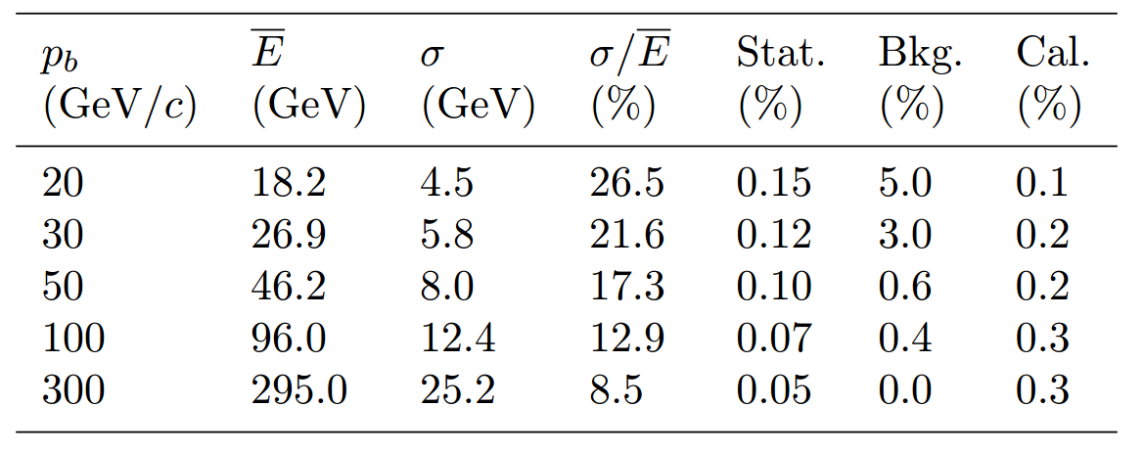
Table 2: The energy resolutions and the associated errors ascribed to statistics, background and the
calibration uncertainties for pions at five different beam momenta.
Source: CMS NOTE 2006/138
The fits are applied to the raw data and no correction is made for the large e/h value of the electromagnetic calorimeter. Results are in agreement with GEANT4 within the systematic errors and the available beam momentum range.

Slide 38
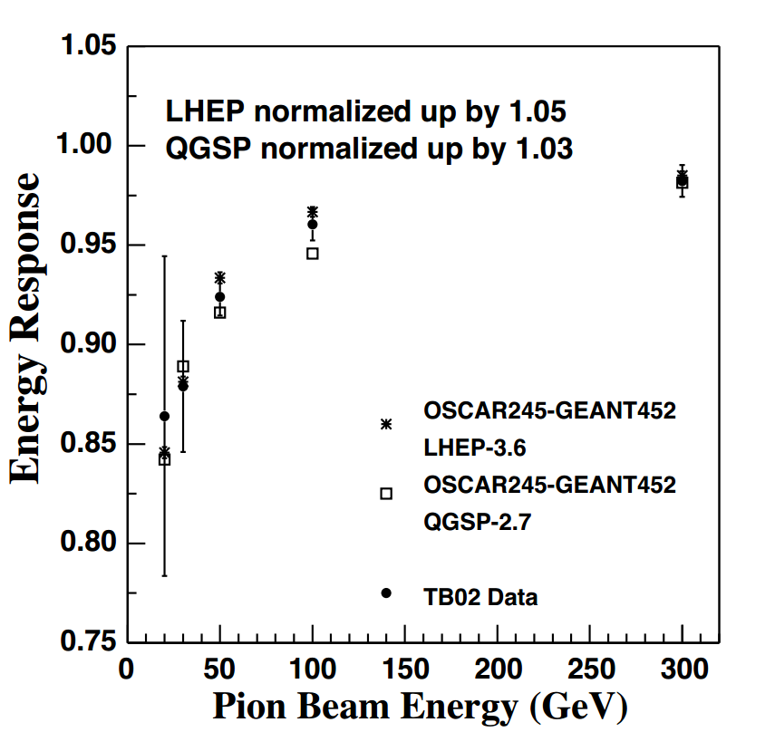
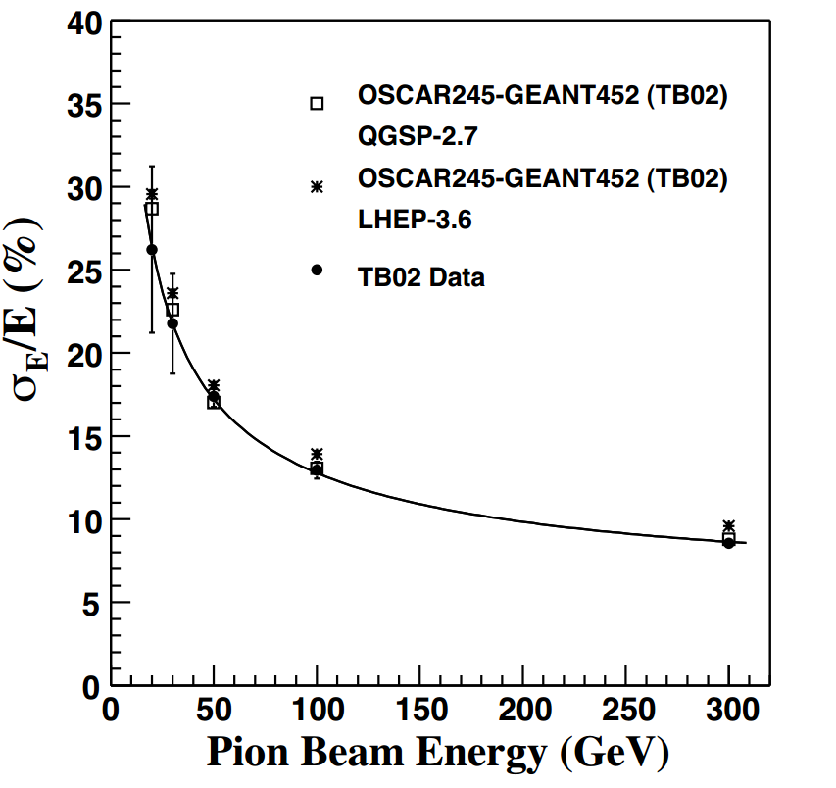
Figure 21: The measured energy resolution(solid circles) with fit (solid line) (σ/E) = 115 √.E 3% ⊕ 5.5% compared to two different tunes of GEANT4 (open squares and stars). The symbol ⊕ implies that two terms are added in quadrature.
Figure 22: The measured energy response (solid circles) linearity compared to the GEANT4 simulations with different physics lists. The error bars indicate the statistical and systematic uncertainties added in quadrature.
Source: CMS NOTE 2006/138

Slide 39
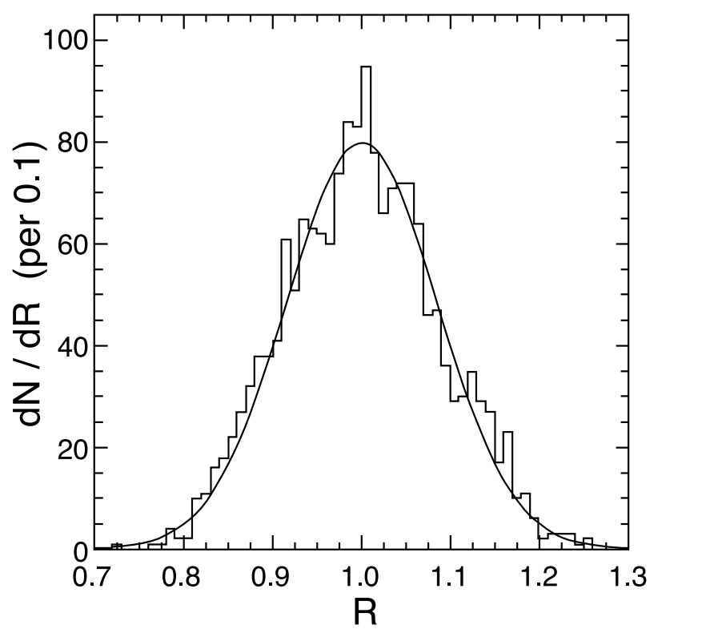
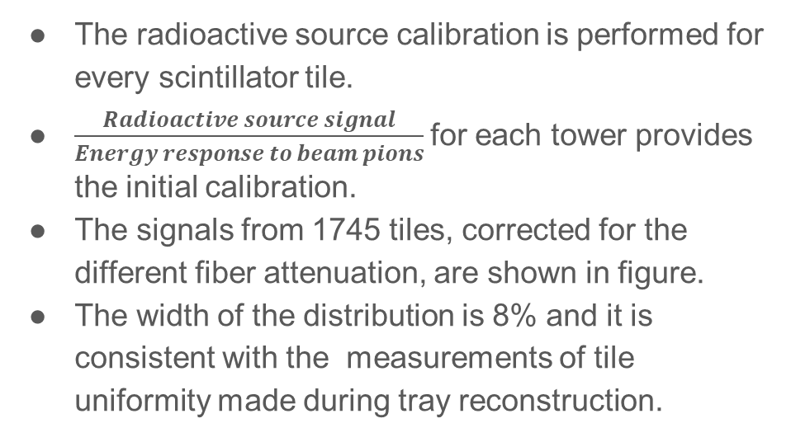
Radioactive Source Calibration
The radioactive source calibration is performed for every scintillator tile.
$\frac{Radioactive source signal}{Energy response to beam pions}$for each tower provides the initial calibration.
The signals from 1745 tiles, corrected for the different fiber attenuation, are shown in figure.
The width of the distribution is 8% and it is consistent with the measurements of tile uniformity made during tray reconstruction.

Slide 40
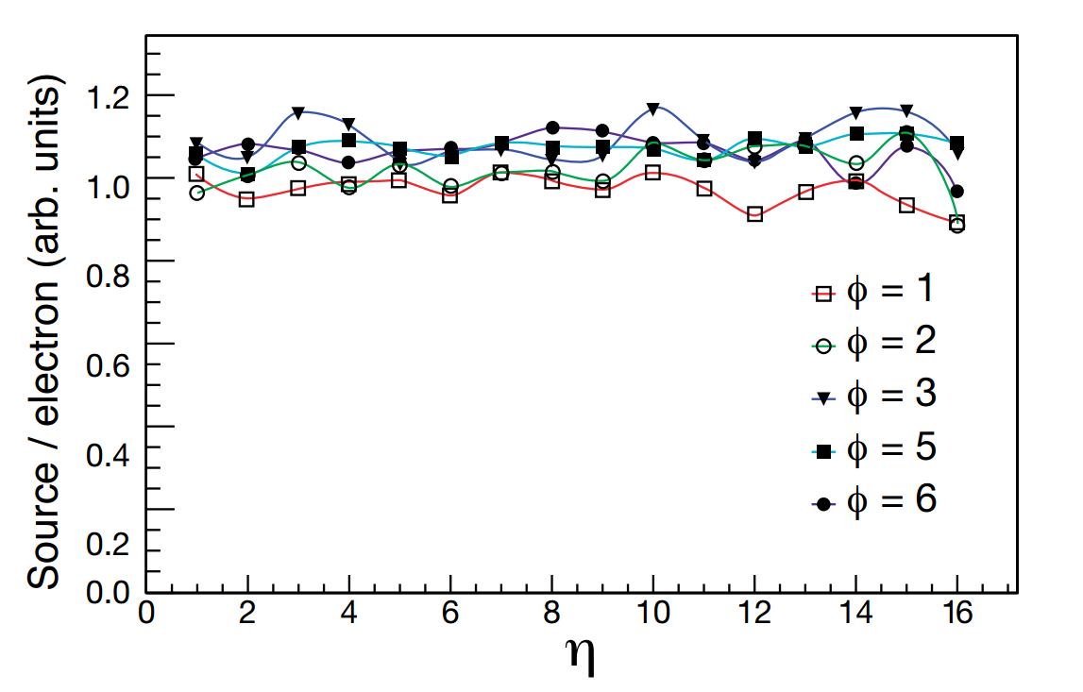
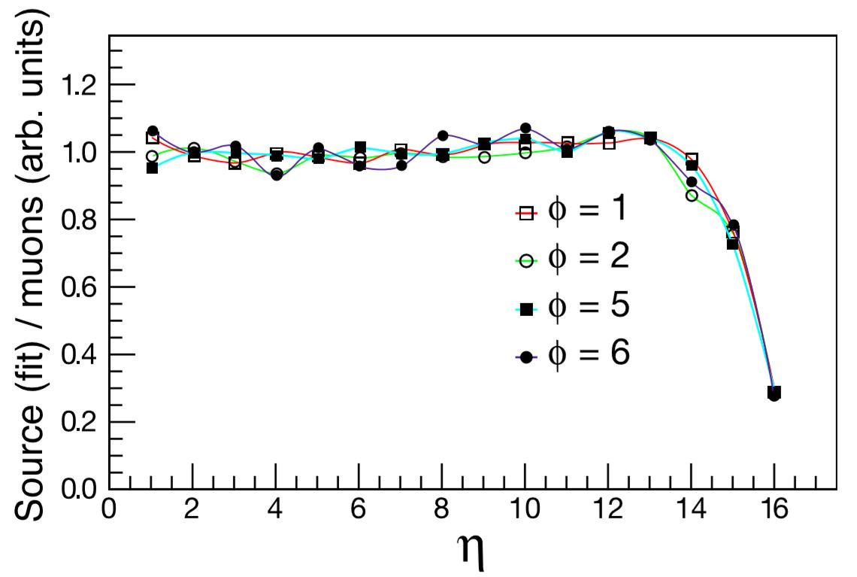
Ratio of the radioactive source signal (fit to peak value) to the 100 GeV/c incident electron signal in the HB vs η number of the tower for five different φ numbers (80 towers total).
Ratio of the radioactive source signal to the HB signal due to a 225 GeV/c beam of incident muons vs η number for four diﬀerent φ numbers (64 towers total).
Towers with the number 15 and 16 have longitudinal segmentation which is not corrected for in this plot

Slide 41
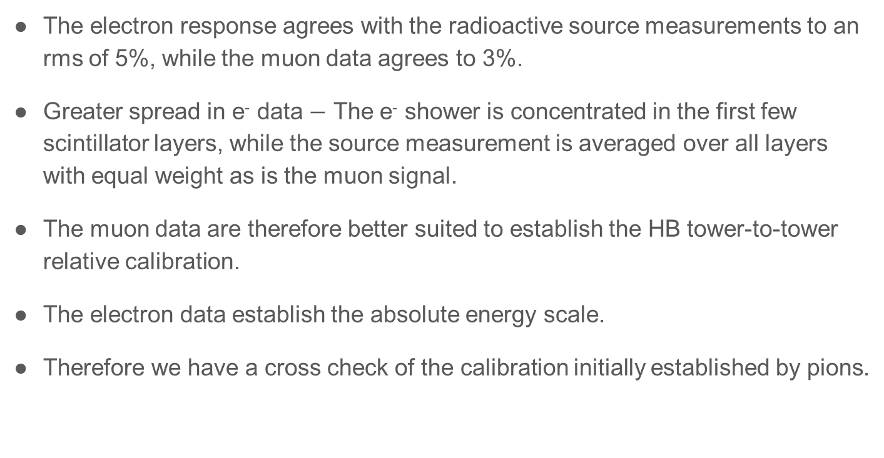
The electron response agrees with the radioactive source measurements to an rms of 5%, while the muon data agrees to 3%.
Greater spread in e⁻ data $−$ The e⁻ shower is concentrated in the first few scintillator layers, while the source measurement is averaged over all layers with equal weight as is the muon signal.
The muon data are therefore better suited to establish the HB tower-to-tower relative calibration.
The electron data establish the absolute energy scale.
Therefore we have a cross check of the calibration initially established by pions.

Slide 42
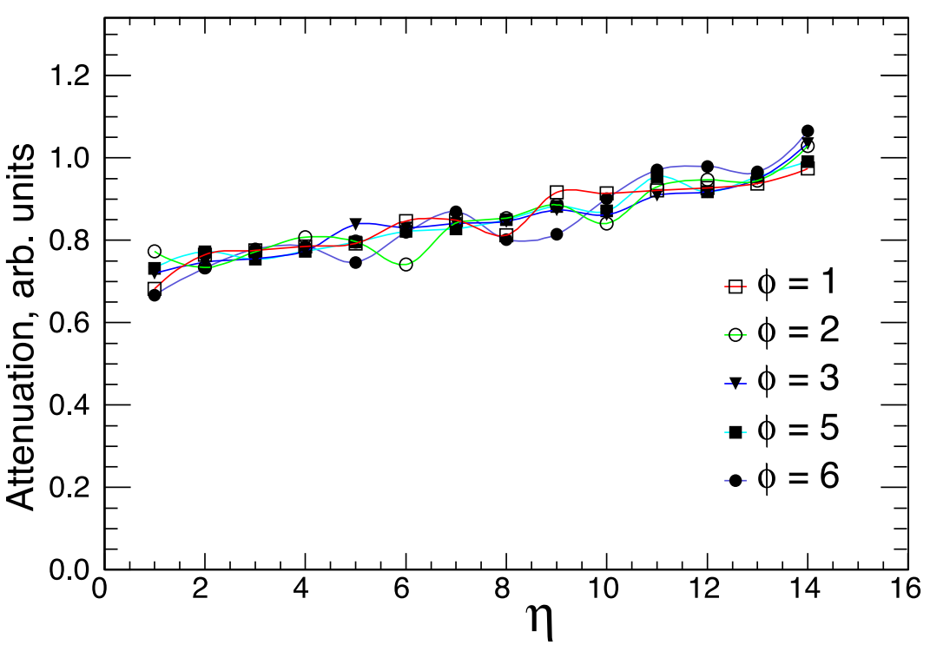
The length of the optical fibers between the scintillators and the HPDs varies with η.
Figure shows measurement of the attenuation vs η number for five different φ numbers.
The light level at the HPD is about 30% lower for η = 1 towers when compared to η = 14 towers.

